Slide 1

TIFFANYANDCO
Instagram Report
BRAND
PERIOD
COMPARISON PERIOD
CHANNEL
@tiffanyandco
20 Jun 2026 - 19 Jul 2026
21 May 2026 - 19 Jun 2026
Instagram

Slide 2

Tiffany & Co.
EXECUTIVE SUMMARY
2/12
Between June 20 and July 19, Tiffany&Co.'s Instagram profile saw a steady rise in its follower base, reaching over 16.8 million followers, although the growth rate slightly slowed compared to the previous period. The account was active, posting 26 times with an increased average post frequency each day.There was a notable increase in engagement in comments, with the average comments per post rising, even though overall likes and total engagement saw a slight decrease. Video and reel content duration extended significantly, correlating with a substantial boost in video views and reel engagement, which more than tripled compared to before.Impressions and reach roughly doubled, highlighting a dramatic expansion in content visibility. Despite the growth in reach and impressions, engagement rates per post and per impression saw a decrease, indicating that while more users are seeing the content, their rate of interaction has diminished.The earned media value indicated by awareness and audience growth also rose notably, supporting the profile's broader impact beyond immediate engagement.
Source: Socialinsider
Date range: 20 Jun 2026 - 19 Jul 2026

Slide 3

KEY INSIGHTS
3/12
One month, three numbers
Overall a positive period, with some room for improvement.
0.07 %
9.7M
6.3M
Avg. Engagement Rate by Followers
Organic Posts Views
Organic Posts Reach
100.97%
81.8%
6.08%
Source: Socialinsider
Date range: 20 Jun 2026 - 19 Jul 2026

Slide 4
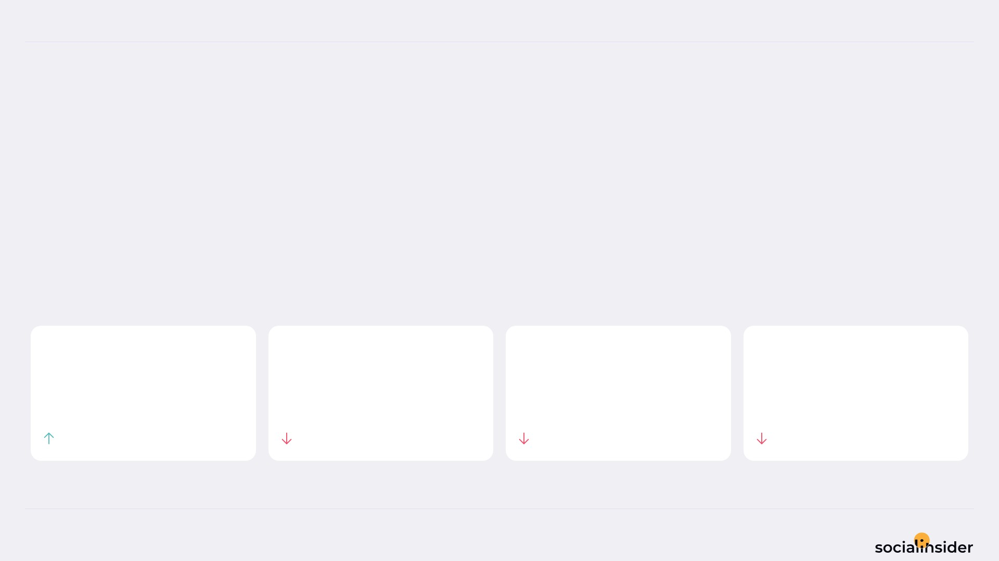
Tiffany & Co.
POSTS PERFORMANCE
4/12
POSTS TO ENGAGEMENT
We posted 4% more, but engagement dropped 2.20%.
More posts produced less engagement — review content quality or frequency.
TOTAL POSTS
TOTAL ENGAGEMENT
AVG ENGAGEMENT / POST
AVG ENGAGEMENT / DAY
26
327.7K
12.6K
10.9K
4%
2.2%
5.96%
2.2%
Source: Socialinsider
Date range: 20 Jun 2026 - 19 Jul 2026

Slide 5
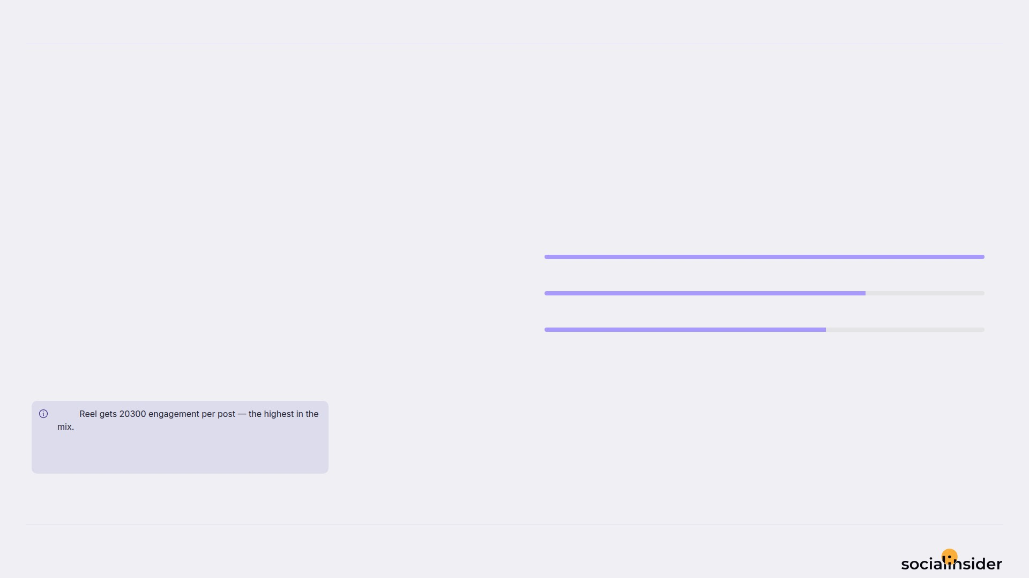
Tiffany & Co.
5/12
WHAT WE PUBLISHED
Image made up the majority of posts published during this period. Reel drove the results.
Image
11
Reel
8
Carousel
7
Image accounted for 42% of posts and 30% of engagement.
Note
Source: Socialinsider
Date range: 20 Jun 2026 - 19 Jul 2026

Slide 6
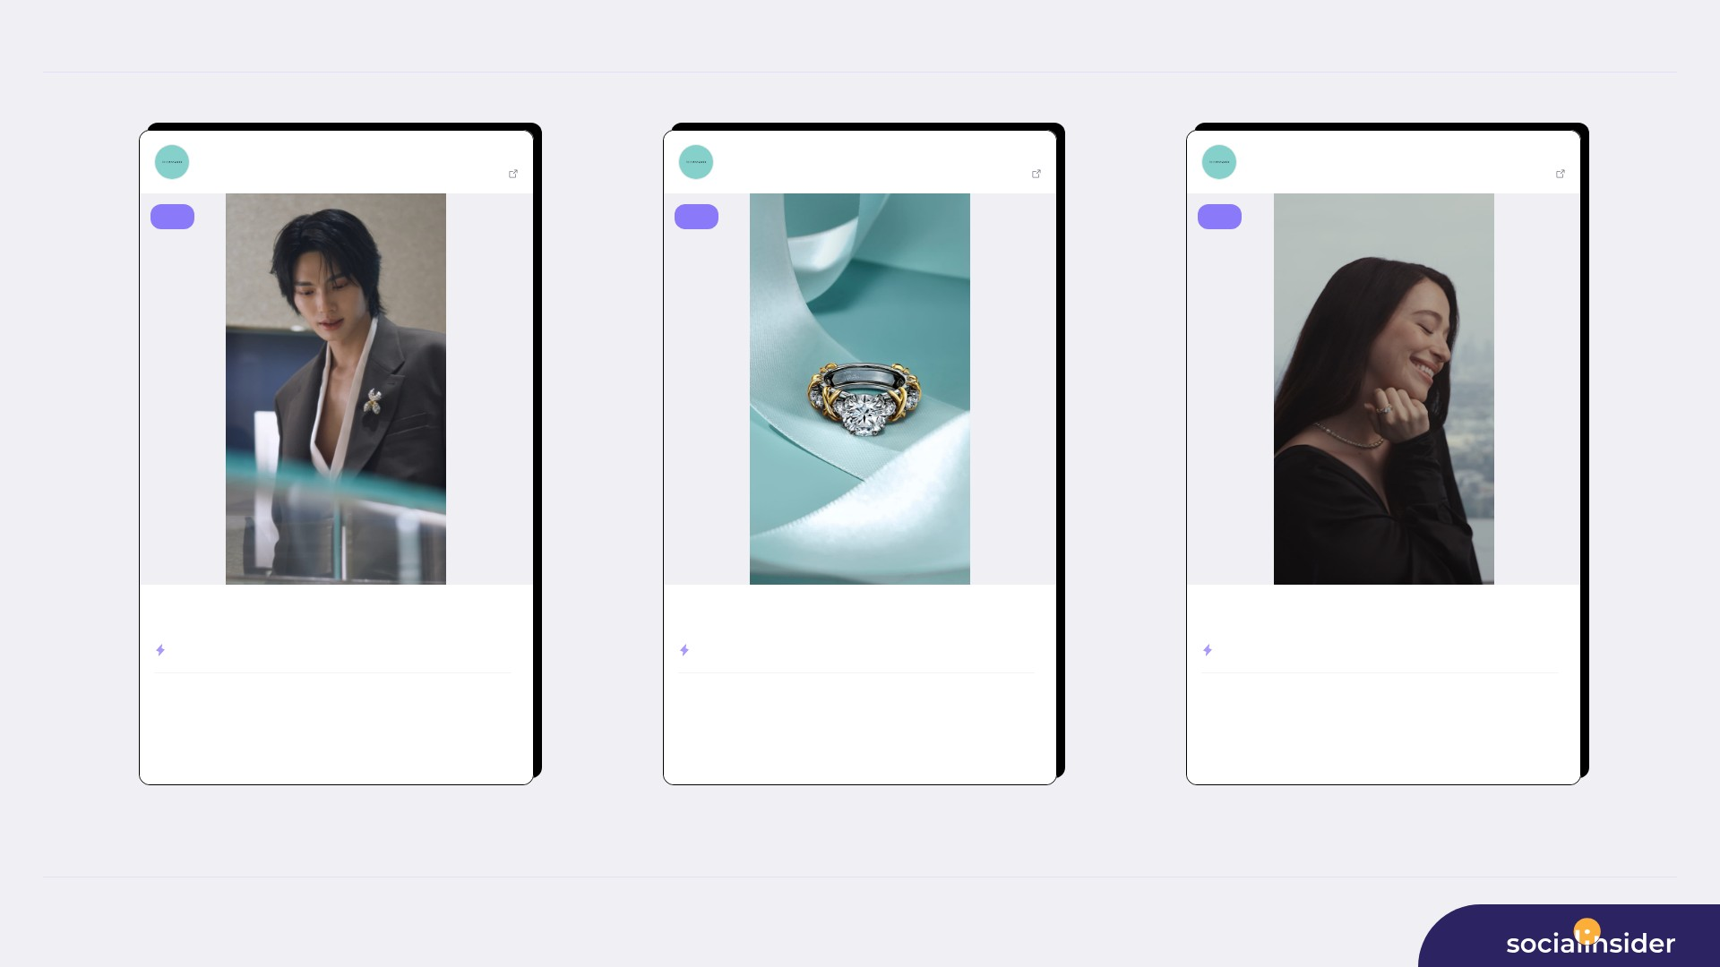
TOP CONTENT
6/12
Tiffany & Co.
Jul 01, 2026
Tiffany & Co.
Jul 07, 2026
Tiffany & Co.
Jul 06, 2026
16840861 followers
View post
16840861 followers
View post
16840861 followers
View post
reel
reel
reel
House ambassadors Anne Curtis and Win Metawin celebrate the opening of...
The House’s iconic Sixteen Stone by Tiffany ring has been reimagined w...
Introducing the Sixteen Stone by Tiffany solitaire diamond ring. Since...
ENGAGEMENT RATE
0.37%
ENGAGEMENT RATE
0.18%
ENGAGEMENT RATE
0.15%
1.4M
62.1K
884K
29.6K
869K
25K
VIEWS
LIKES
VIEWS
LIKES
VIEWS
LIKES
632
858K
366
550.8K
251
541.4K
COMMENTS
REACH
COMMENTS
REACH
COMMENTS
REACH
Source: Socialinsider
Date range: 20 Jun 2026 - 19 Jul 2026

Slide 7
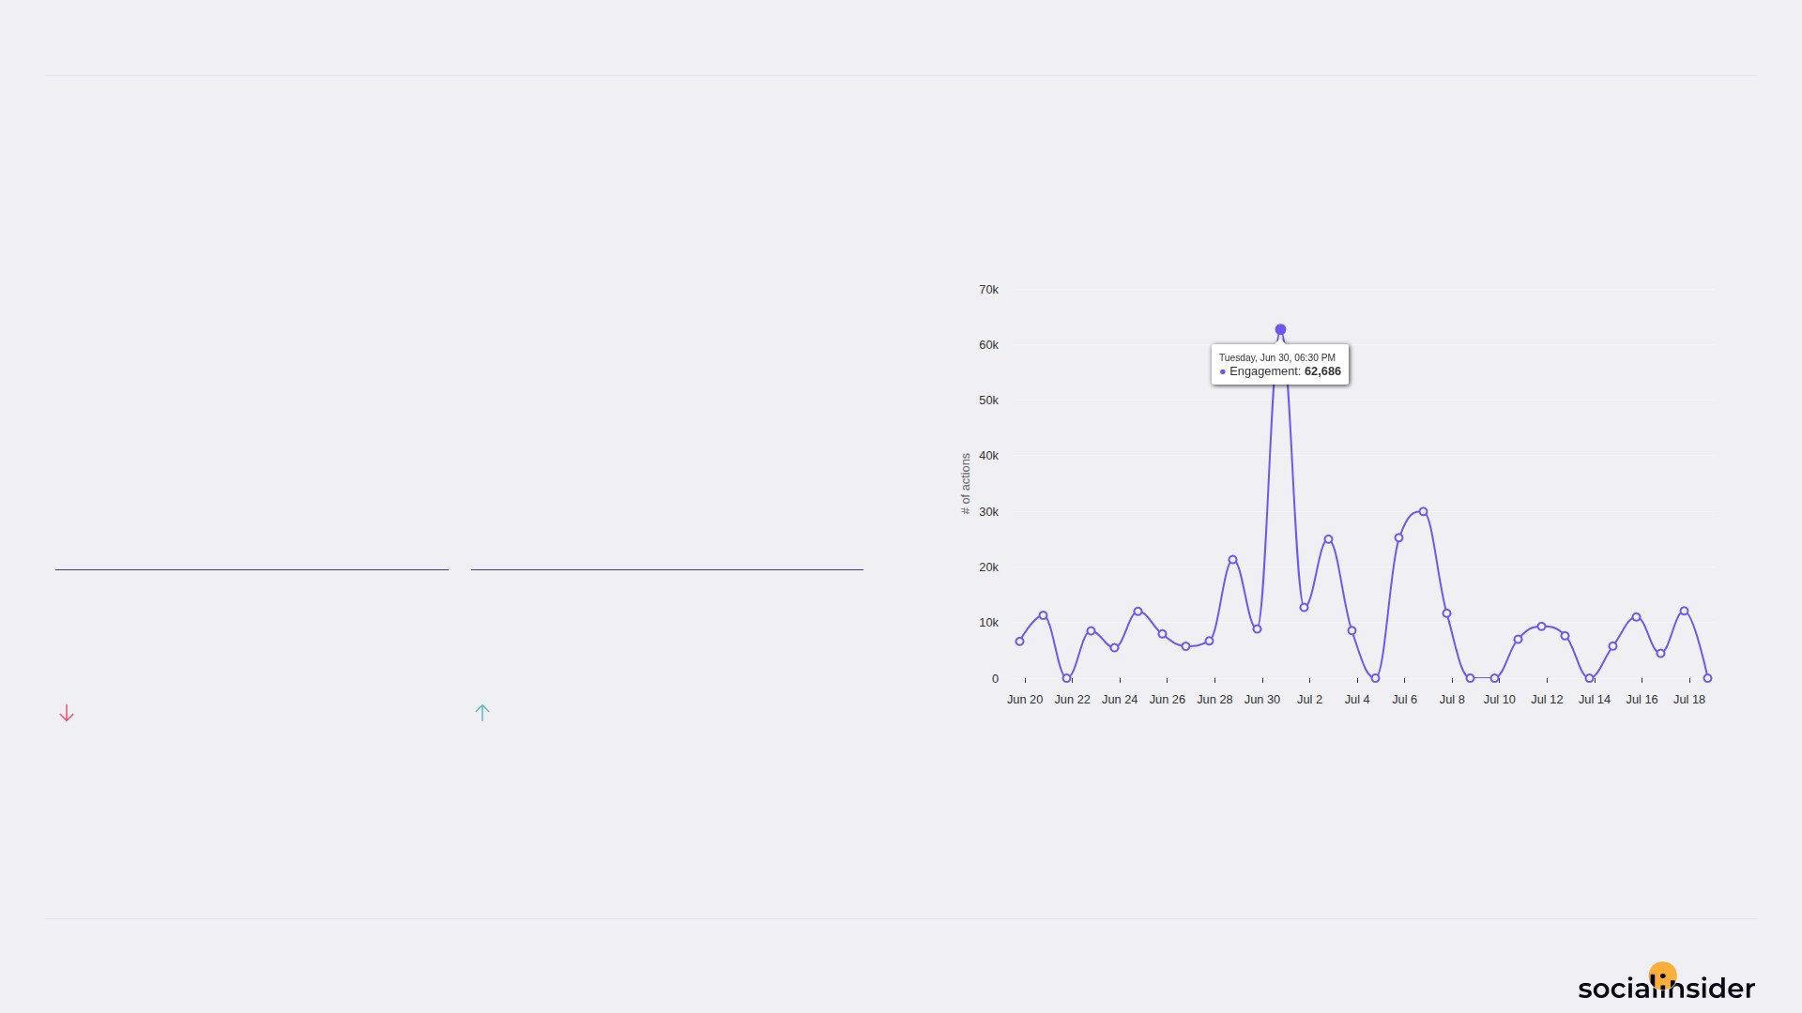
Tiffany & Co.
ENGAGEMENT
7/12
Engagement trend over the selected period
324.3K Total Organic Likes — a volatile period.
Total Organic Likes fell while Total Organic Comments held — Total Organic Comments is the bright spot.
TOTAL ORGANIC LIKES
TOTAL ORGANIC COMMENTS
324.3K
3,374
2.39%
20.24%
Source: Socialinsider
Date range: 20 Jun 2026 - 19 Jul 2026

Slide 8
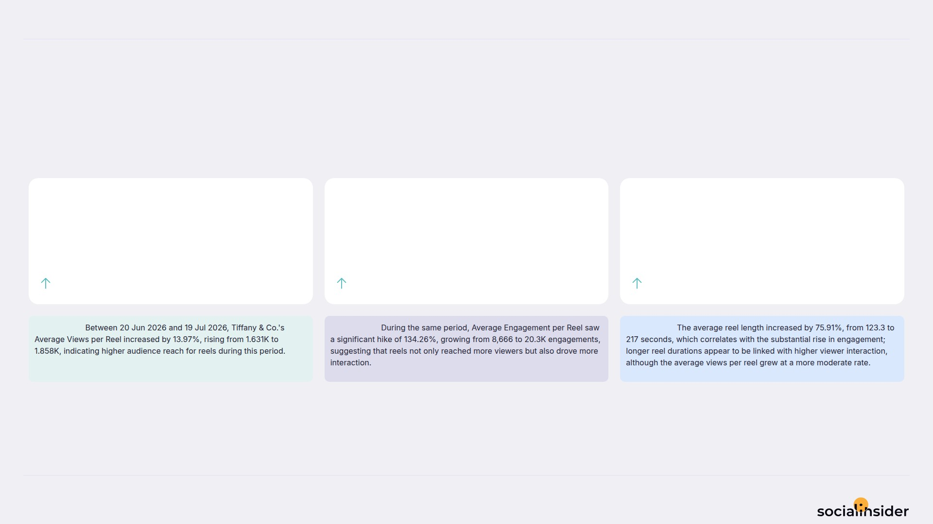
Tiffany & Co.
REELS
8/12
Key metrics for reels published during the period
Reels increased across the board this period.
AVG VIEWS / REEL
AVG ENGAGEMENT / REEL
AVG REEL LENGTH
1.9
20.3K
217
13.97%
134.26%
75.91%
Observation:
Observation:
Observation:
Source: Socialinsider
Date range: 20 Jun 2026 - 19 Jul 2026

Slide 9
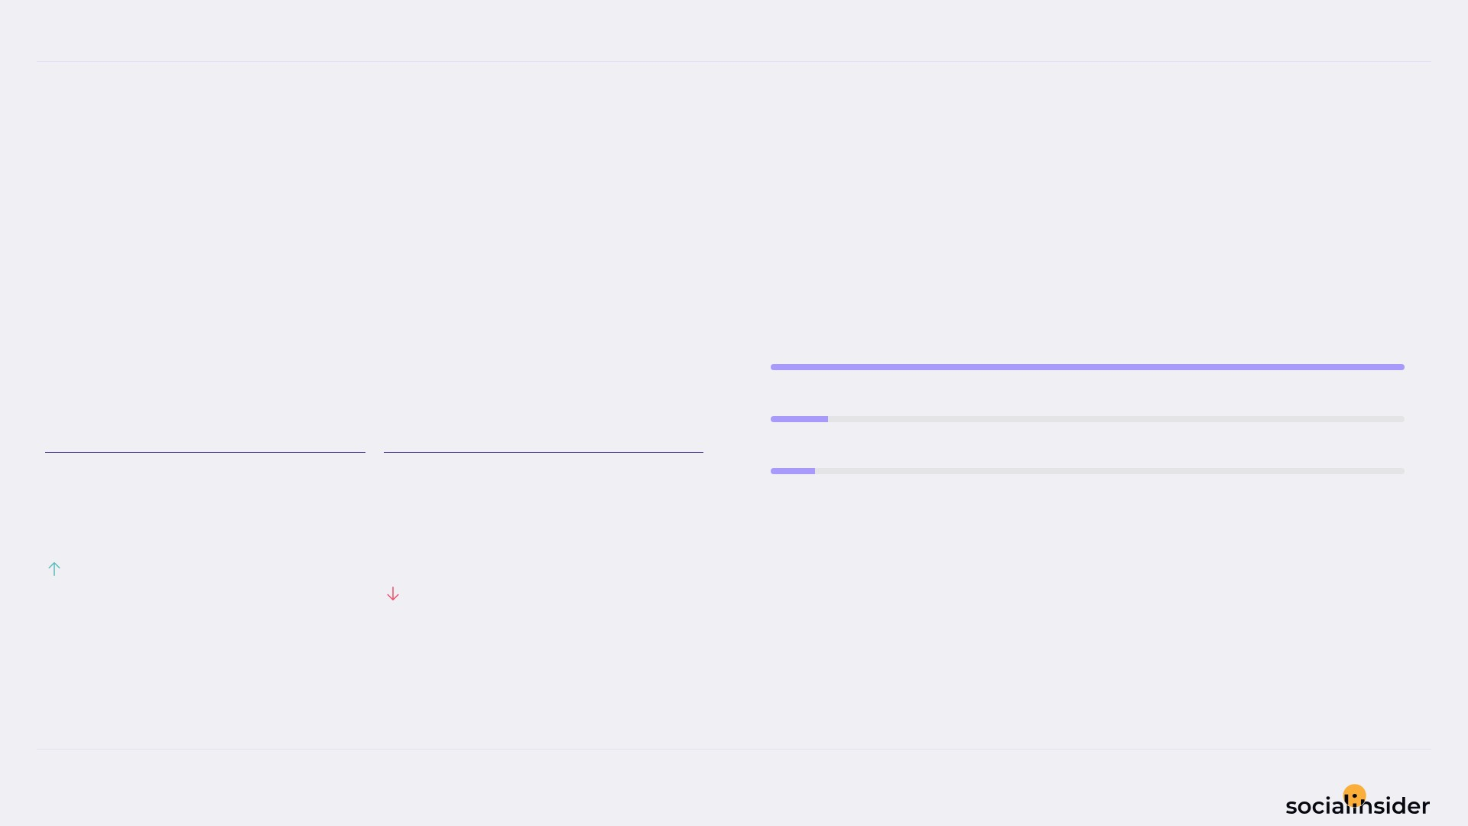
Tiffany & Co.
REACH
9/12
Reach performance broken down by post type
243.2K Avg Reach / Post — declining this period.
Avg Reach / Post grew but Avg Engagement Rate by Reach dropped — worth monitoring.
Reel
5.4M
Image
498K
Carousel
381K
AVG REACH / POST
AVG ENGAGEMENT RATE BY REACH
243.2K
14.1
%
81.8%
7.36%
Source: Socialinsider
Date range: 20 Jun 2026 - 19 Jul 2026

Slide 10
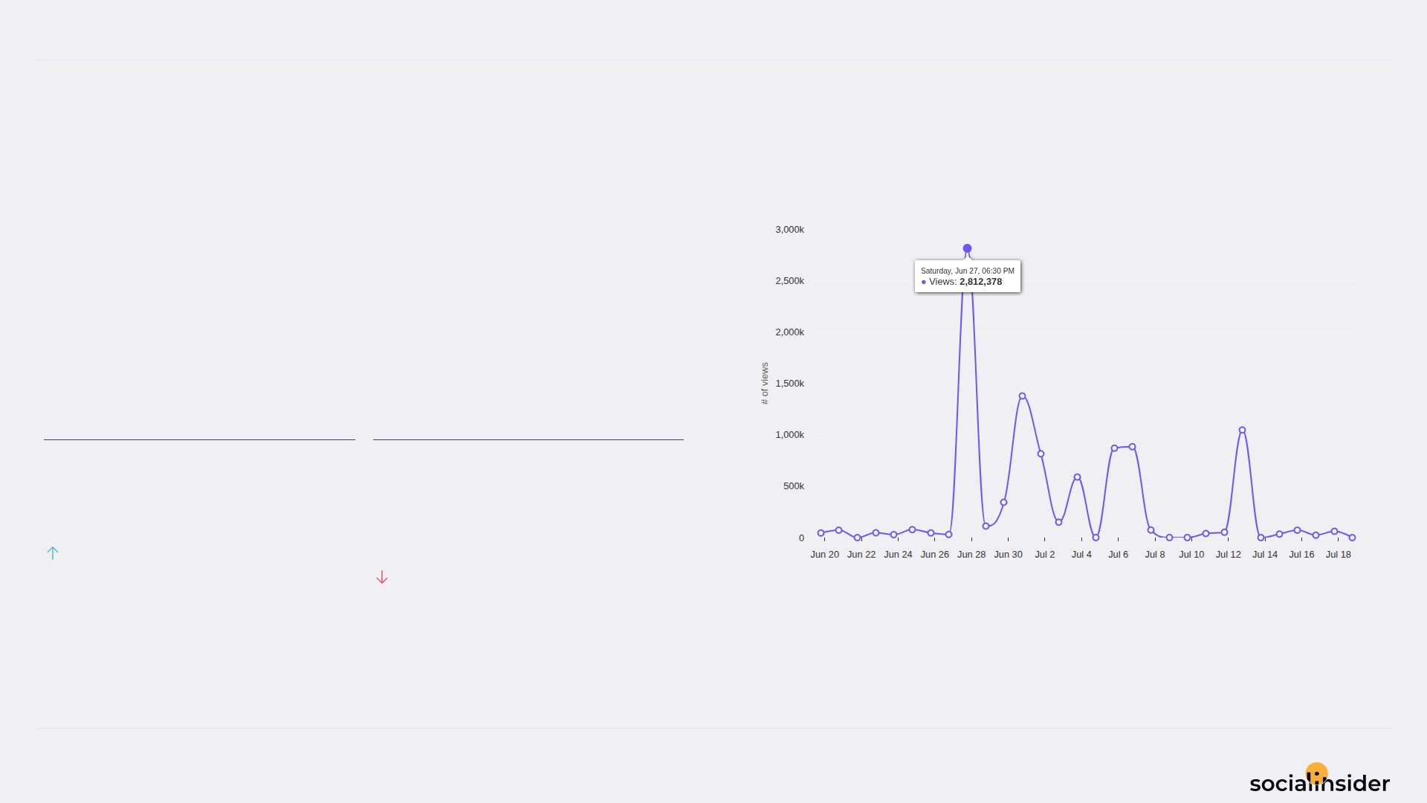
Tiffany & Co.
VIEWS
10/12
Views performance
373.3K Avg Views / Post — a volatile period.
Avg Views / Post grew but Avg Engagement Rate by Views dropped — worth monitoring.
AVG VIEWS / POST
AVG ENGAGEMENT RATE BY VIEWS
373.3K
12.5
%
93.24%
8.29%
Source: Socialinsider
Date range: 20 Jun 2026 - 19 Jul 2026

Slide 11
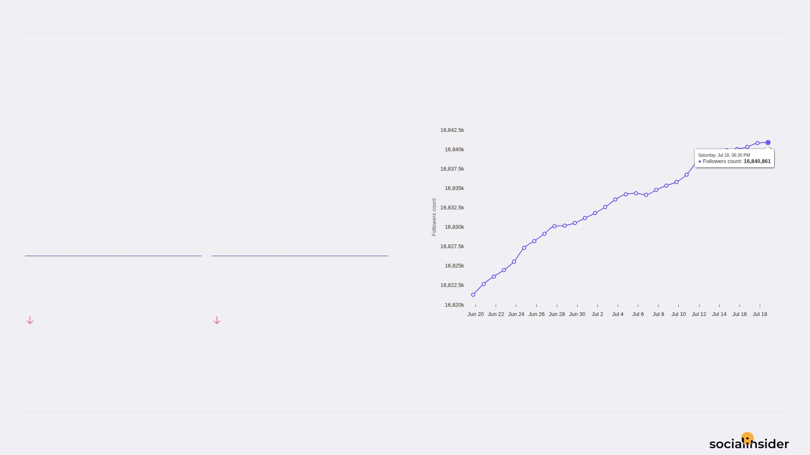
Tiffany & Co.
FOLLOWERS
11/12
Follower growth trend over the selected period
19.6K Follower Growth — holding steady.
Both Follower Growth and Followers Growth % declined this period.
FOLLOWER GROWTH
FOLLOWERS GROWTH %
19.6K
0.1
18.71%
18.83%
Source: Socialinsider
Date range: 20 Jun 2026 - 19 Jul 2026

Slide 12

REFERENCE
12/12
Definitions and reference materials for this report
Glossary & Resources
Scope
Definitions
Resources
Period
Engagement
Socialinsider Blog
20 Jun 2026 - 19 Jul 2026
The sum of likes and comments on the organic posts
socialinsider.io/blog
Comparison Period
Engagement Rate by Followers
Socialinsider Help Center
21 May 2026 - 19 Jun 2026
Engagement divided by follower count, expressed as a percentage
https://howto.socialinsider.io/en/
Social Channel
Reach
Socialinsider Studies
Instagram
Number of unique accounts that saw your content
https://www.socialinsider.io/reports
Content Analysis (posts analyzed)
Views
26
Total number of times your content was displayed
Source: Socialinsider
Date range: 20 Jun 2026 - 19 Jul 2026

